Slide 1
Presentation on Computer Hardware

Slide 2
Over View
_{About Computer}
_{Parts of computer}
_{parts of cpu}

Slide 3
What is Computer
COMPUTER stands for "A computer is a general purpose electronic device that is used to perform arithmetic and logical operations automatically.
C-Common
O-Operating
M-Machine
P-Purposely
U-Used for
T-Technological and
E-Educational
R-Research

Slide 4
Parts of Computer
HARDWARE
Software

Slide 5
Software
Software is a collection of programs
procedure, instruction that perform
some task on computer. Software Can be store in hardware.

Slide 6
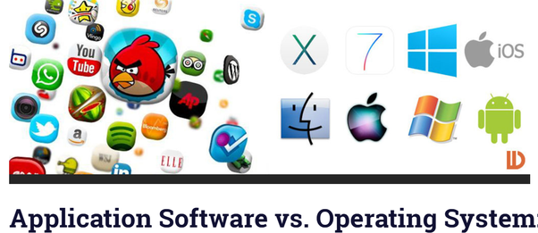

Slide 7
Computer Hardware
Monitor
Mouse
Keyboard
Speaker
C.P.U (Central Processing Unit)

Slide 8
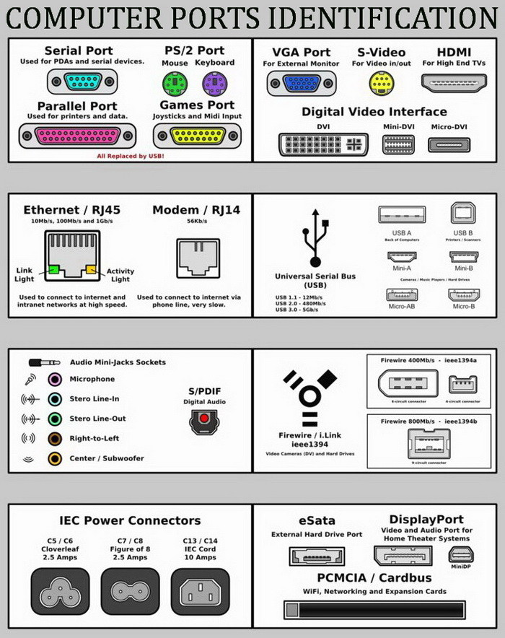
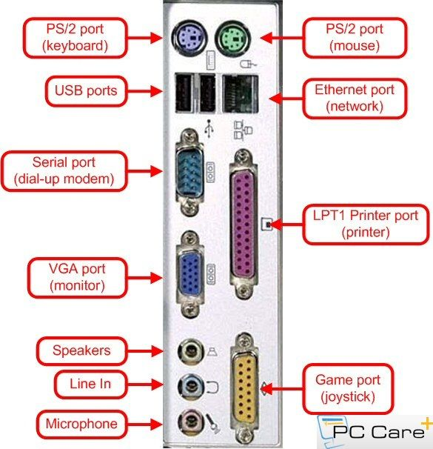

Slide 9
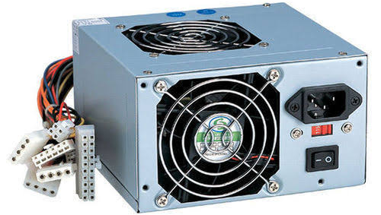
Parts of C.P.U
SMPS – Switched Mode Power Supply.

Slide 10
2. DRIVES
SDD – Solid State Drive.
HDD – Hard Disk Drive.
SSHD – Solid State
Hybrid Drives.

Slide 11
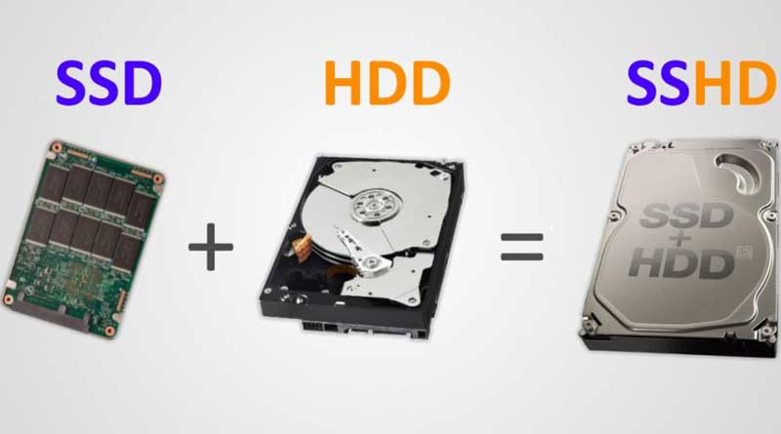

Slide 12
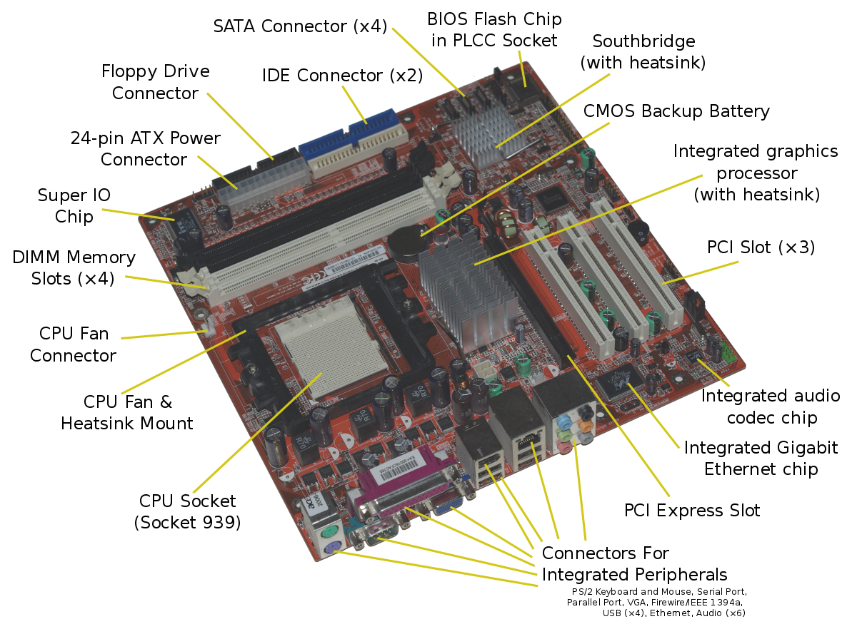
MOTHERBOARD

Slide 13
4. CABLES 1. PATA – Parallel Advance Technology Attachment. 2. SATA – Serial Advance Technology Attachment. 3. M2slot

Slide 14
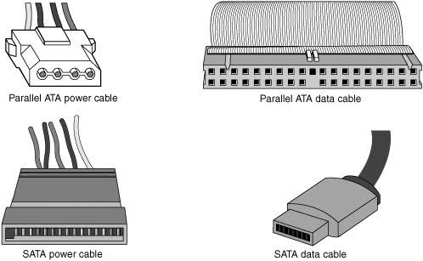

Slide 15
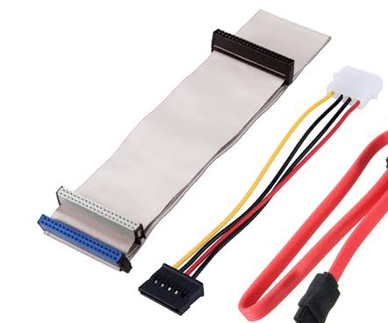


Slide 16
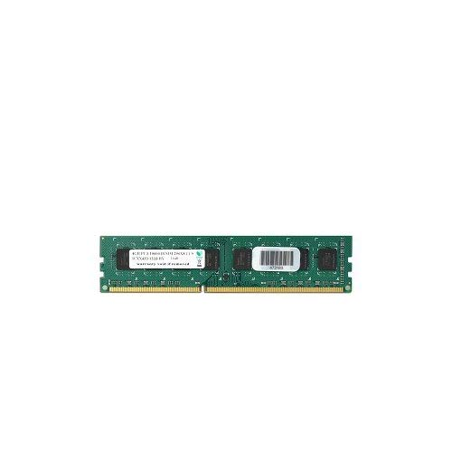
5. Memory 1. RAM – Random Access Memory 1. Virtual ram 2. Physical Ram 2. ROM – Read Only Memory

Slide 17
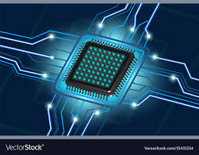
Processor

Slide 18
THANK YOU

